Slide 1
Containerization
Docker idea, use-cases, and key skills

Slide 2
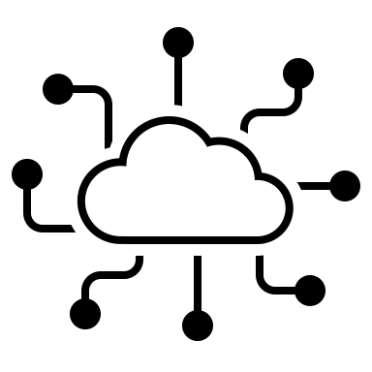
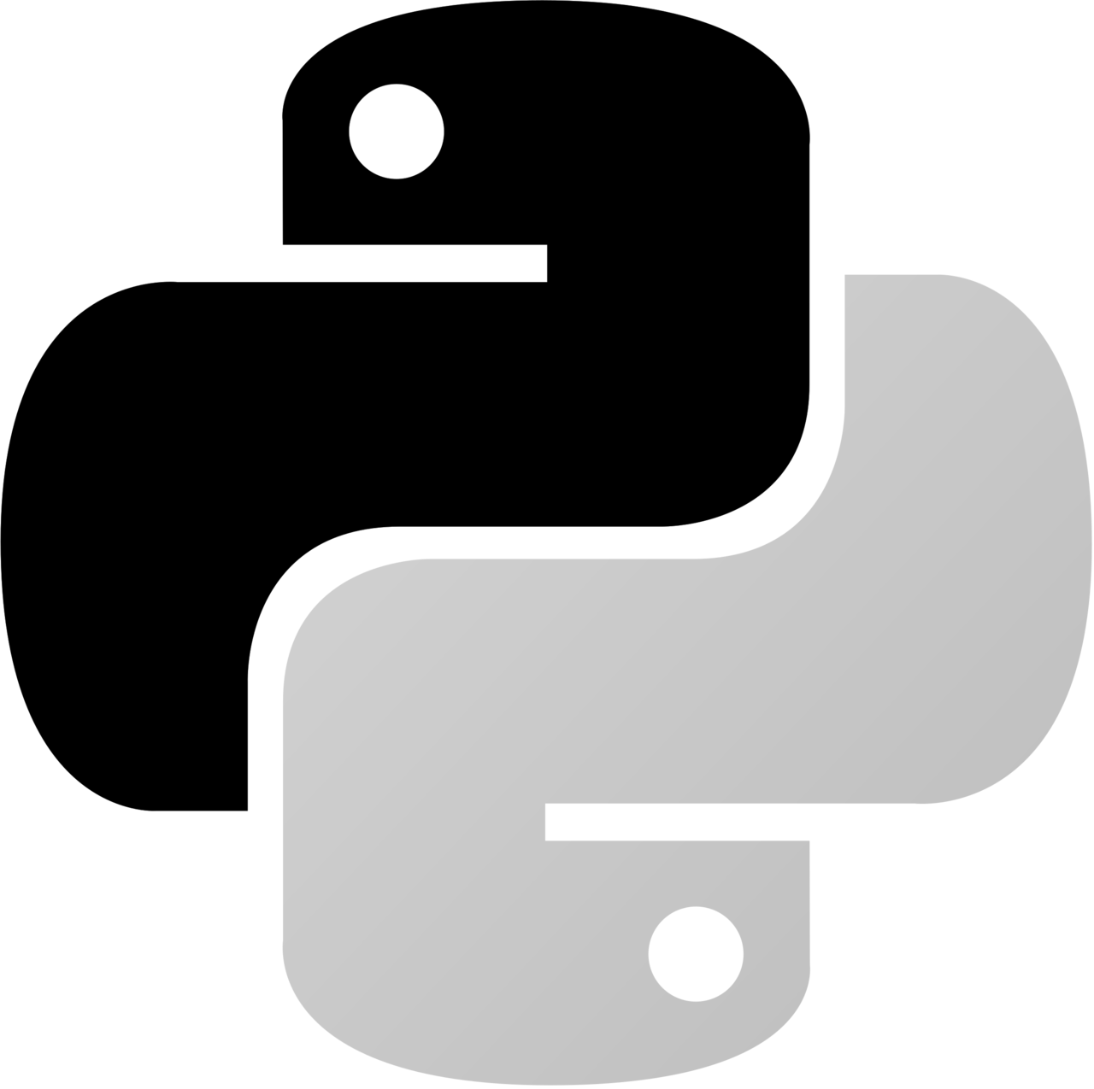


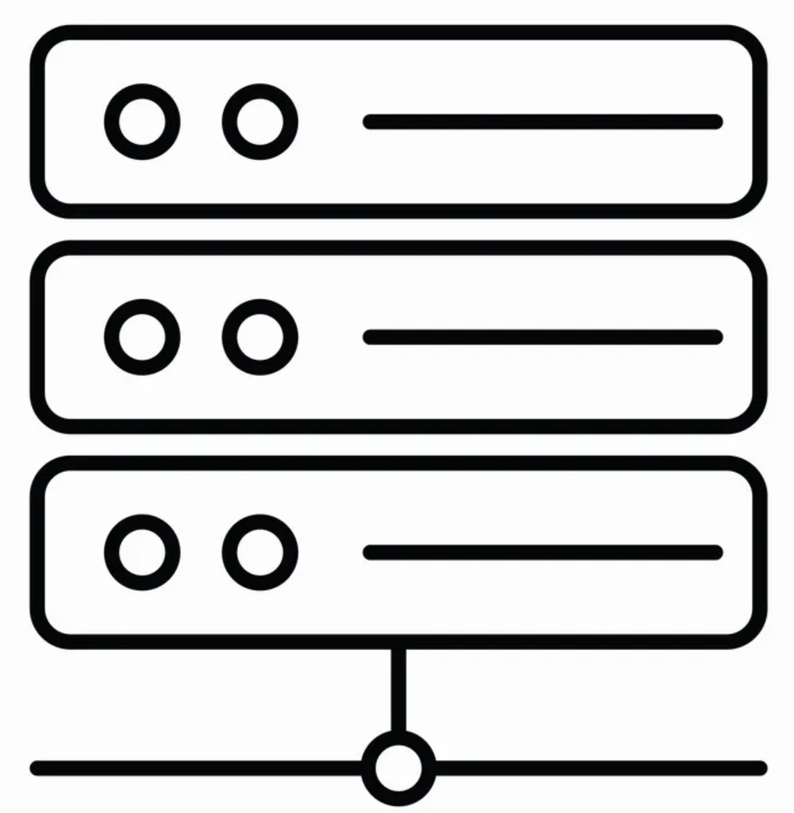
test.csv
kafka
data.csv
data_prep.py
model_eval.csv
train.csv
train.py
model.pkl
evaluate.py
.csv
Notes:
Wyobraźmy sobie bardzo elementarny przepływ trenowania modelu uczenia maszynowego, na który składają się etapy przygotowania danych, trenowania i ewaluacji modelu.
Proces ten najczęściej nie jest prostą sekwencją kroków, ale procesem zawierającym różne rozgałęzienia i artefakty pochodzące z różnych źródeł.

Slide 3
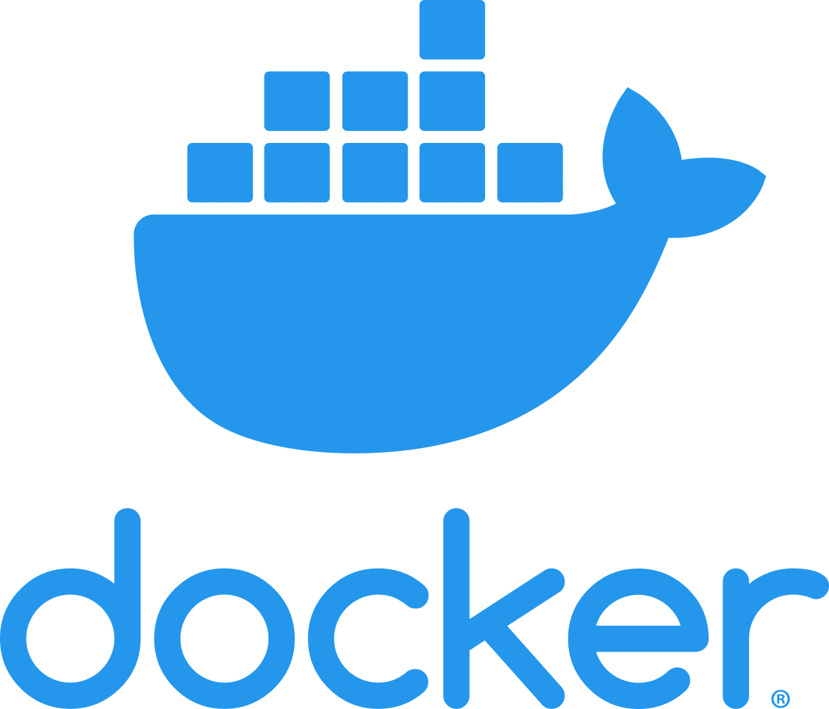
Notes:
Na szczęście istnieje wiele metod i technik umożliwiających efektywne zarządzanie tak złożonymi procesami i systemami. Wśród nich jedną z ważniejszych jest tzw. konteneryzacja, która najczęściej wdrażana jest z wykorzystaniem środowiska Docker.

Slide 4
Setup
Image
Container
Docker.com account
Docker application
The docker hub repository
Local launch
Publishing
Launching in another system
$ docker build
Your App
Dockerfile
Image
$ docker run

Slide 5
Why?

Slide 6

Portability
Between computers, environments and systems

Slide 7
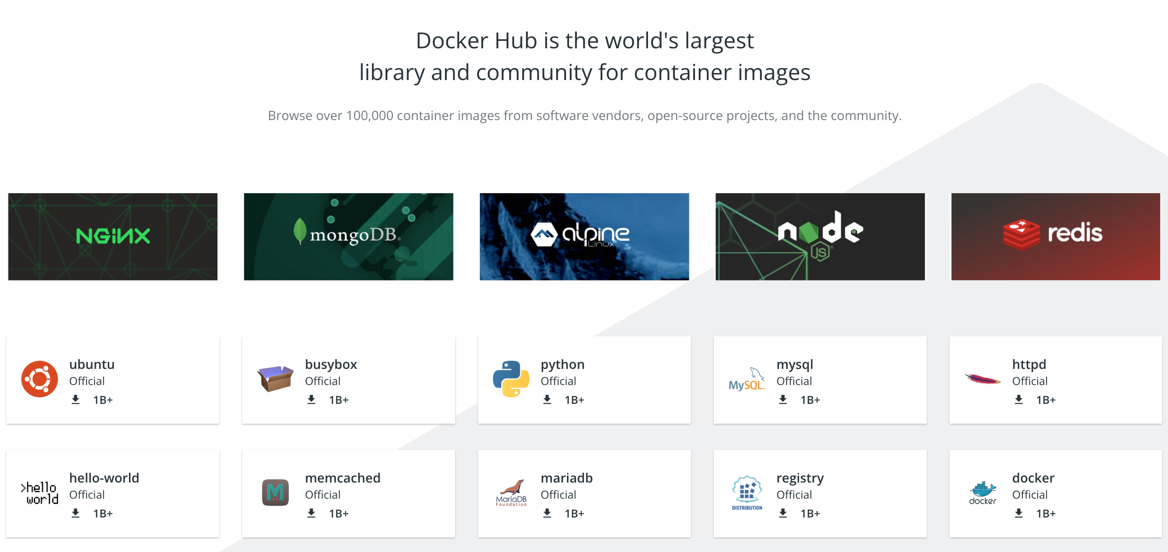
Reusability
Ability to use components provided by others

Slide 8
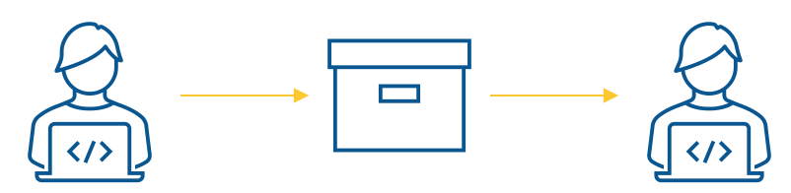
Reproducibility
Ability to reproduce the results of other teams

Slide 9
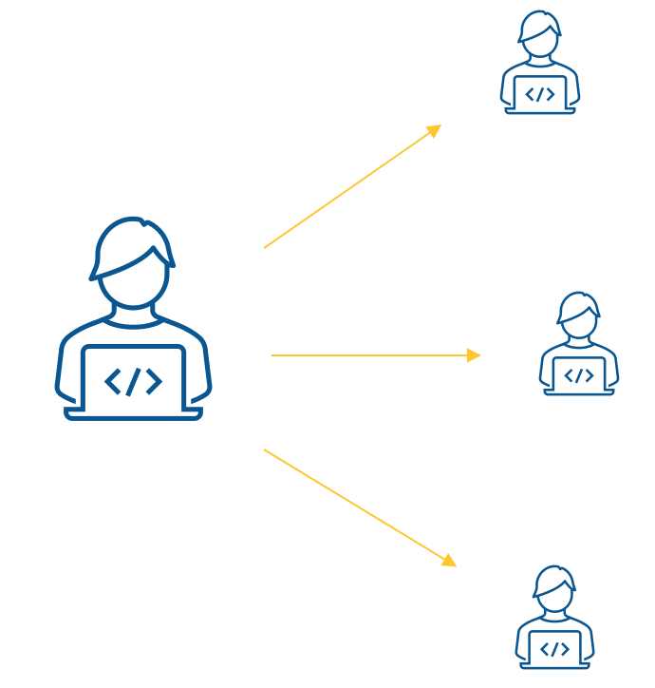
Productivity
Improve your own productivity
Working more effectively with others

Slide 10
Use cases
How to use Docker in Data Science projects?

Slide 11
Organization

Slide 12

I want to quickly bring a new employee into the project
A new employee is joining our team
We want to quickly prepare a machine (PC, server, notebook)
Instead of installing a set of packages: we run a Docker container

Slide 13
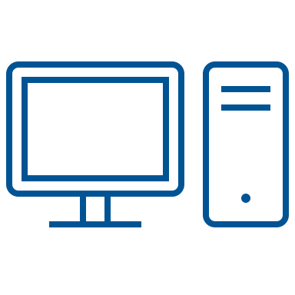

I want to continue working on my project on another computer
I frequently change location: travel, return home, etc.
I would like to be able to perform calculations, train models or test the application on the computers I have access to
They differ not only in operating systems, but also in the environments installed on them and the hardware configuration. In particular, some of them cannot use gas pedals such as graphics cards
Instead of installing dedicated environments on each of them, I run the docker container with different parameters (e.g. with or without GPU acceleration)

Slide 14
Development

Slide 15
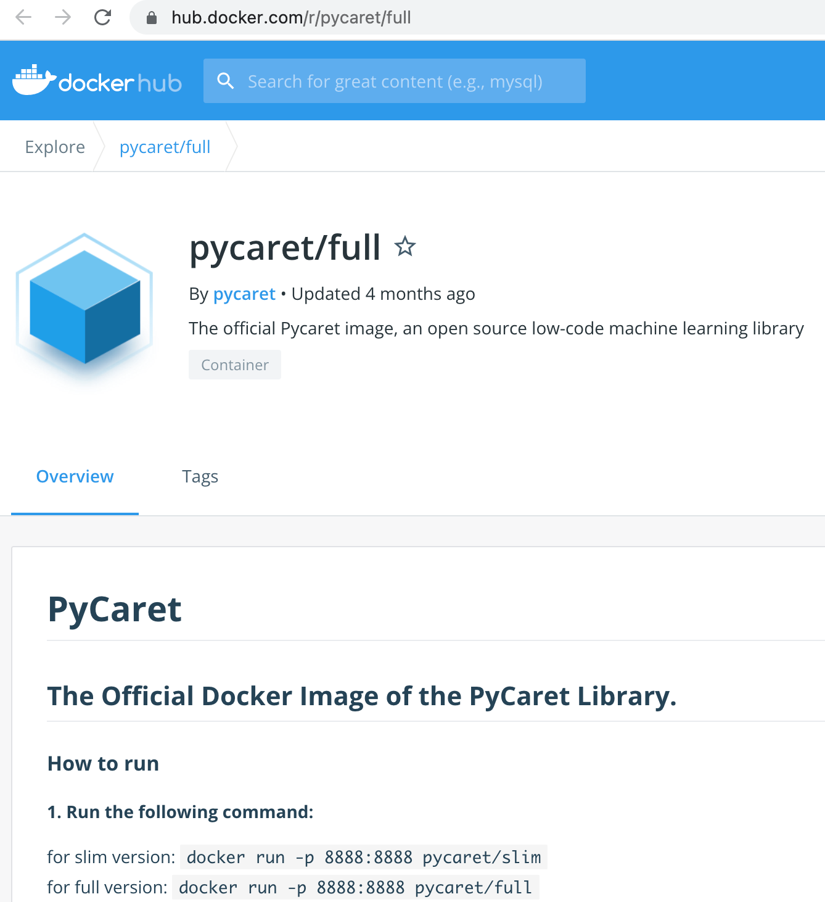
I want to quickly test the performance of a new machine learning library
However, I do not want to create a dedicated virtual environment, install the appropriate packages. Etc.
I acquire the official application image (containing a properly configured environment) and run the appropriate component

Slide 16
I want to create a new machine learning service by combining off-the-shelf components
I use https://hub.docker.com/ to get the relevant images (a bit like an app "store")
I link them together in a pipeline using docker compose

Slide 17
I want to demonstrate an ML application to other team members
... but so that they can experiment with the relevant components themselves if necessary.
(e.g., change data, training algorithms, final application, etc.).
I provide them with a docker image with the appropriate environment and a set of source codes

Slide 18
Sharing

Slide 19

I want to share an application using a database with others
My application uses a database (such as Redis, PostgreSQL or MySQL)
I want to make it available to people who do not have it installed, nor can they configure or manage it
I use docker compose to create a multi-container application, containing both my application and the corresponding database
+

Slide 20
I want to conduct training on Data Science
I want to show someone a solution in jupyter notebook, using various libraries (such as PyCaret)
Users do not have any environments installed
I ask them to install Docker and then run my container

Slide 21

By archiving the project, I want to ensure the reproducibility of my solution in the future
I document and publish my solution's docker image in the image repository accordingly

Slide 22
Development

Slide 23
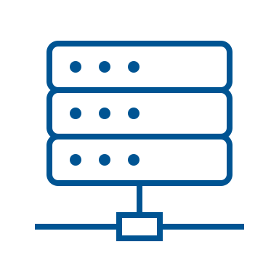

I want to pass host-specific data to the container (e.g. as runtime parameters)
I use docker bind mount for this purpose
$(”env”)

Slide 24
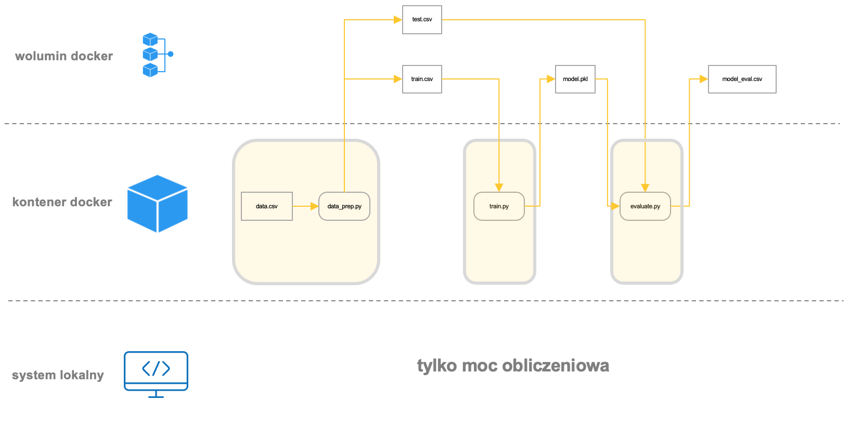
I want to ensure the continuity of my application
so that subsequent container runs with my application can use the results of previous runs
I use docker volume for this purpose

Slide 25
I want different containers to exchange data
I use docker volume for this purpose

Slide 26


I want to store the data used by my containers with a cloud provider
I use docker volume for this purpose

Slide 27

I want to simulate a production environment
Our image analysis system is running on an NVidia Jetson Nano endpoint device
On my workstation, I want to simulate how the latest version of my model will behave on this device
To do this, I run a Docker container with an image of the end device

Slide 28
I want to run multiple services or a sequence of services on the edge device
To do this, I use docker compose to create a launch of several services: in parallel or in the appropriate sequence
a1
k1
a2
k2
a3

Slide 29
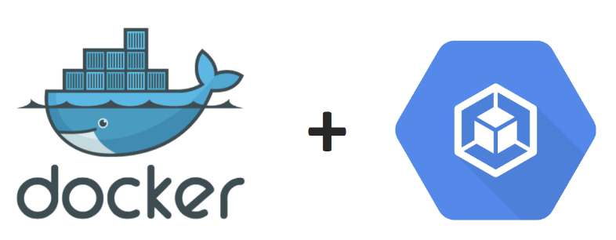
I want to run my ML project in a scalable environment
such as Kubernetes, or at a service provider (GCP, MS Azure or Amazon EC2)
I create a separate image for each component of my machine learning process
I use the Kubeflow system to manage the full process in Kubernetes

Slide 30
Necessary skills
What do you need to know to successfully implement containerization?

Slide 31
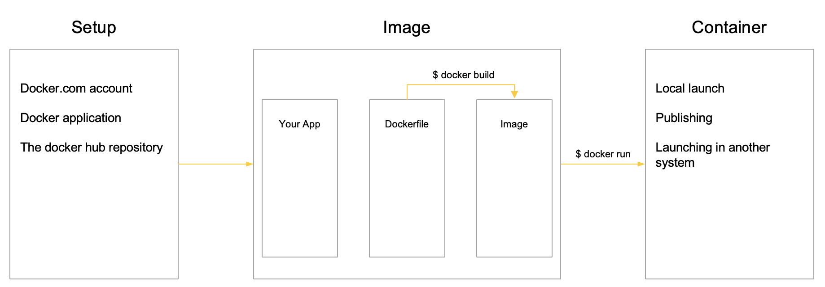
Standalone application
Designing an image using Dockerfile
Building the image
Sharing the image with others
Downloading the image and running the container

Slide 32
Use of existing containers
Identification and use of already created images
- from public repositories
- from your own repository

Slide 33
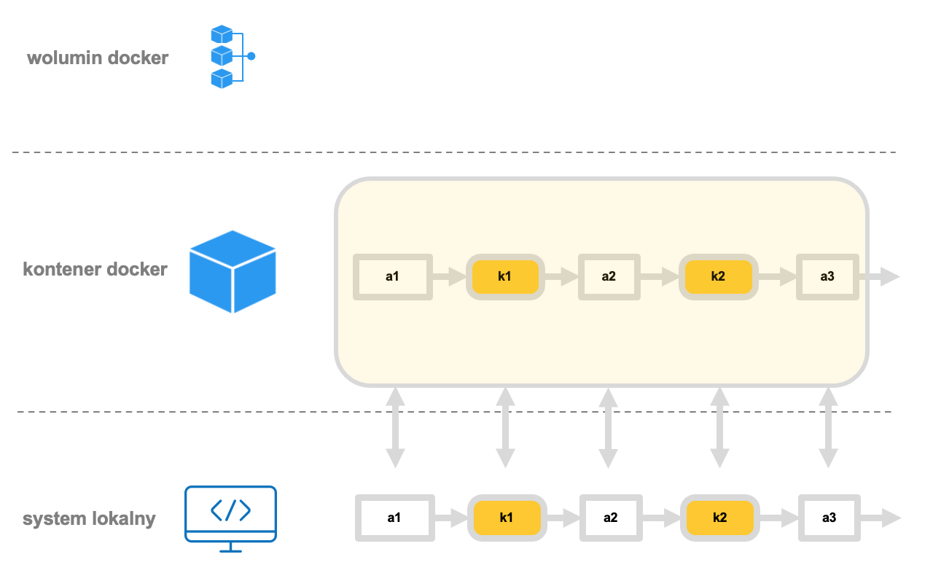
File exchange container<>host
Selection and implementation of the case-optimal strategy for information exchange between containers and the host
Information
- Data
- Control parameters
- Files
Methods
- Docker volume
- Docker bind-mount
- Networking

Slide 34
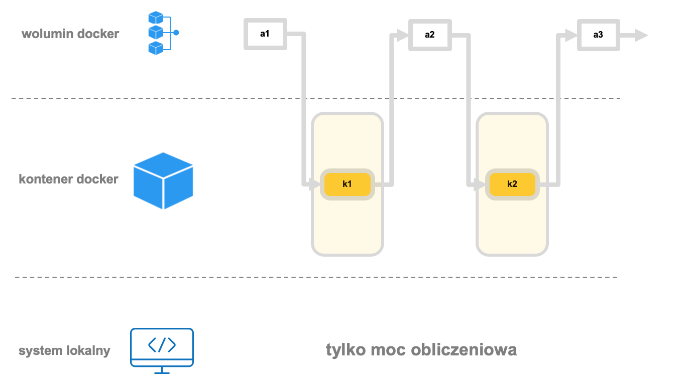
Multi-container applications
Designing, provisioning, and running multi-container applications:
- Parallel, independent services
- Services exchanging data with each other
- Services running sequentially

Slide 35
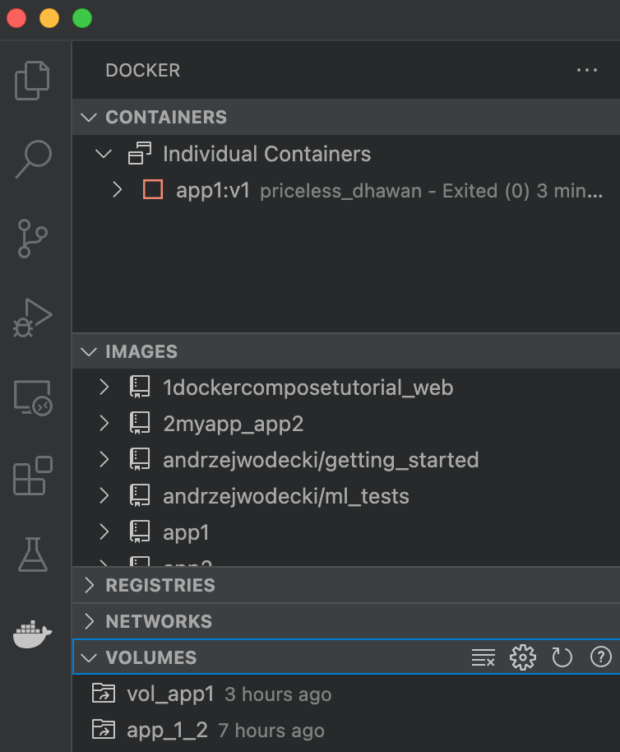
Image, container and volume management
Command line
Docker Desktop application
IDE environments, such as MS VSCode

